Slide 1
Eigenfaces Facial Recognition
By Brendon Hahm and David Dadiomov

Slide 2
Facial Recognition
Countless applications
Need for quick computational time
Often algorithms and models are difficult to understand

Slide 3
PCA and Eigenfaces

Slide 4
PCA Steps
Standardize and Center Data
Eigen Decomposition
Choose k principal components
Project Data from principal components

Slide 5
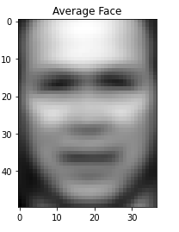
Mean Face (Standardize)
If we calculate the average of each column (pixel), then we get the “mean face”
This mean face can then be subtracted from each face in the dataset (m times) to get the matrix of differences of faces from the mean face
Normal standardization achieves this

Slide 6
Covariance Matrix and Eigenfaces (Eigendecomposition)
If we have a mxn dataset of images subtracted by mean face, then our covariance matrix will be a nxn matrix with the covariance of every feature (pixel) with each other
We calculate the eigenvectors and eigenvalues of the covariance matrix
Each eigenvector has a corresponding eigenvalue and all of these eigenvectors are called eigenfaces
Sort eigenvectors according to eigenvalues in descending order and choose first k eigenvectors

Slide 7
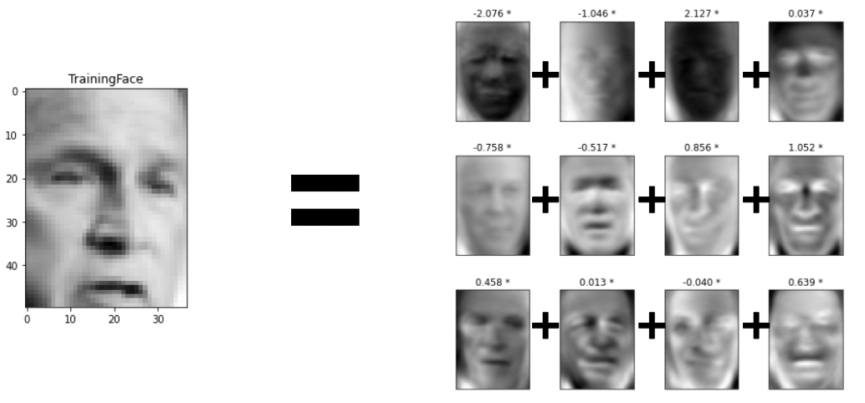
Eigenfaces
Each eigenface is the derived eigenvector
For a single image, the mean face subtracted image when applied to the k eigenfaces produces k features of the face
The linear combination of the k features approximates the original face

Slide 8
How Many Eigenfaces To Select?
To determine k, we can select the minimum eigenfaces that capture some x% of the variance
Ultimately k is arbitrary but if you have a target percent variance, this can be a good method
These eigenfaces are also called the principal components of the distribution of faces

Slide 9
Turk and Pentland
Matthew Turk and Alex Pentland developed this method first in 1991
Matthew Turk, Alex Pentland; Eigenfaces for Recognition. J Cogn Neurosci 1991; 3 (1): 71–86. doi: https://doi.org/10.1162/jocn.1991.3.1.71

Slide 10
Eigenfaces Project

Slide 11
Model Building

Slide 12
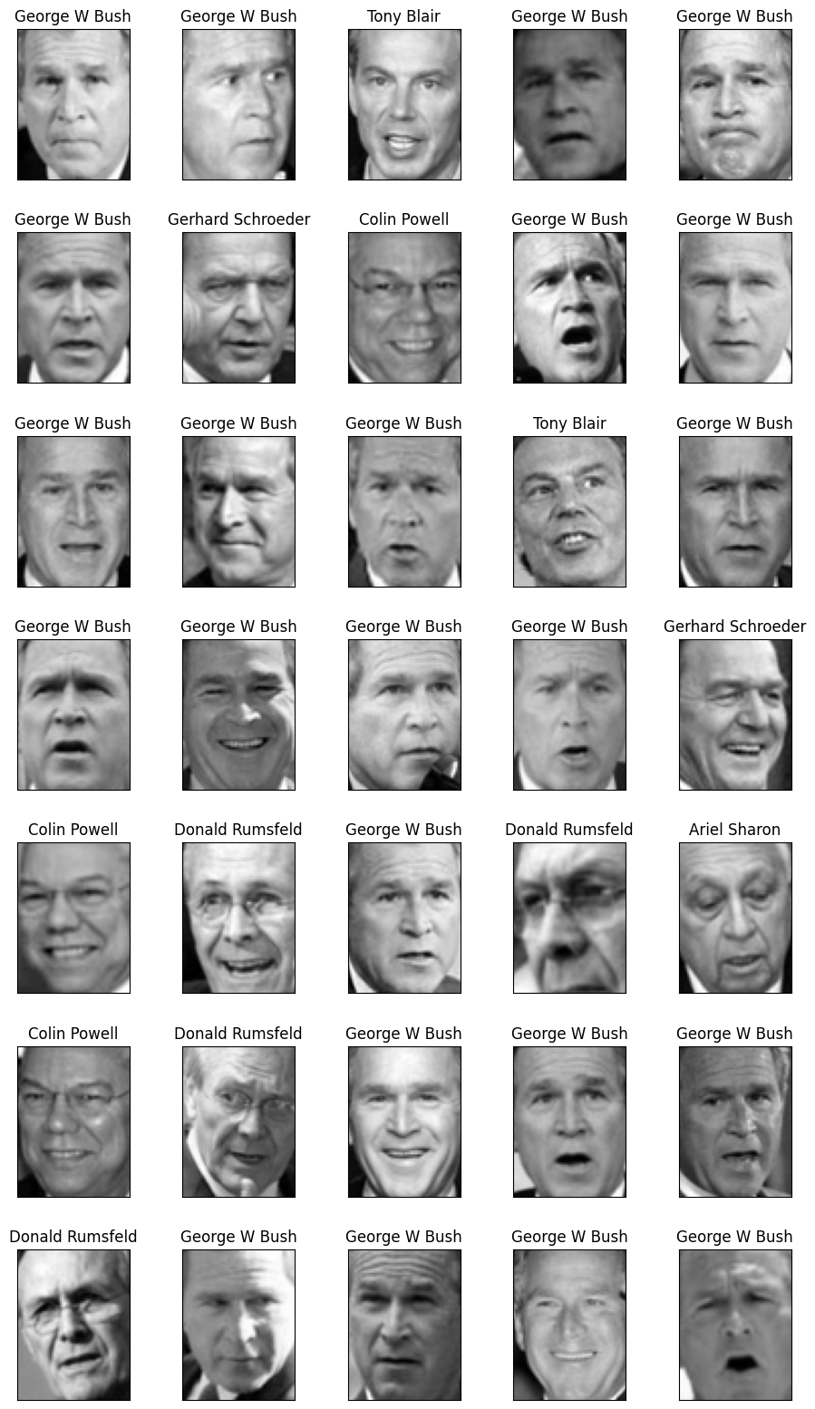
Data
Data consists of 1288 observations with 4200 features (pixels)
Each observation is a 56x75 image (width x height)
There are 7 classes:
Ariel Sharon
Colin Powell
Donald Rumsfeld
George W Bush
Gerhard Schroeder
Hugo Chavez
Tony Blair
There are at least 70 observations for each class

Slide 13
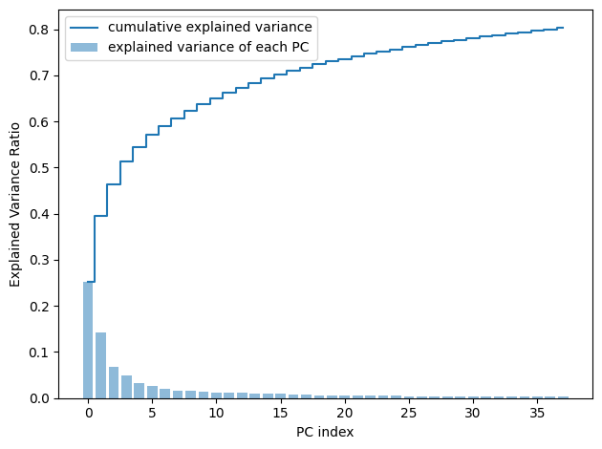
PCA Data
Value of K chosen by 80% of variance explained
K = 38
First principal component explain about 25% of variance with each successive PC explaining less than the previous
Data being not very collinear requires higher value of K

Slide 14
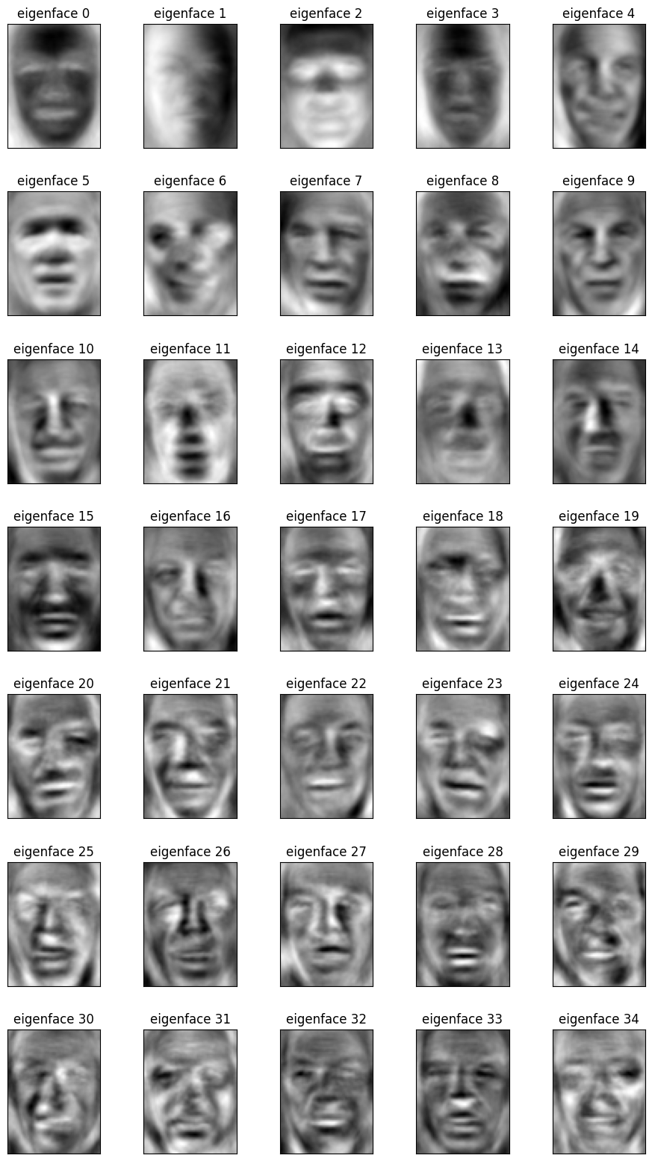
Eigenfaces
Eigenfaces show the “characteristic” features of the image data
These visualizations shows these characteristic features
The characteristic features are all relative to the “mean face”

Slide 15
Principal Components, Noise, and Accuracy
To see the effects of PCA on modeling, we ran a 1NN model since it is a simple algorithm and the benefits of PCA should be well exemplified in it
Without PCA
Testing Accuracy: 0.628
With PCA
Testing Accuracy: 0.713
How can accuracy increase when our chosen k only explains 80% of the variance of our data?

Slide 16
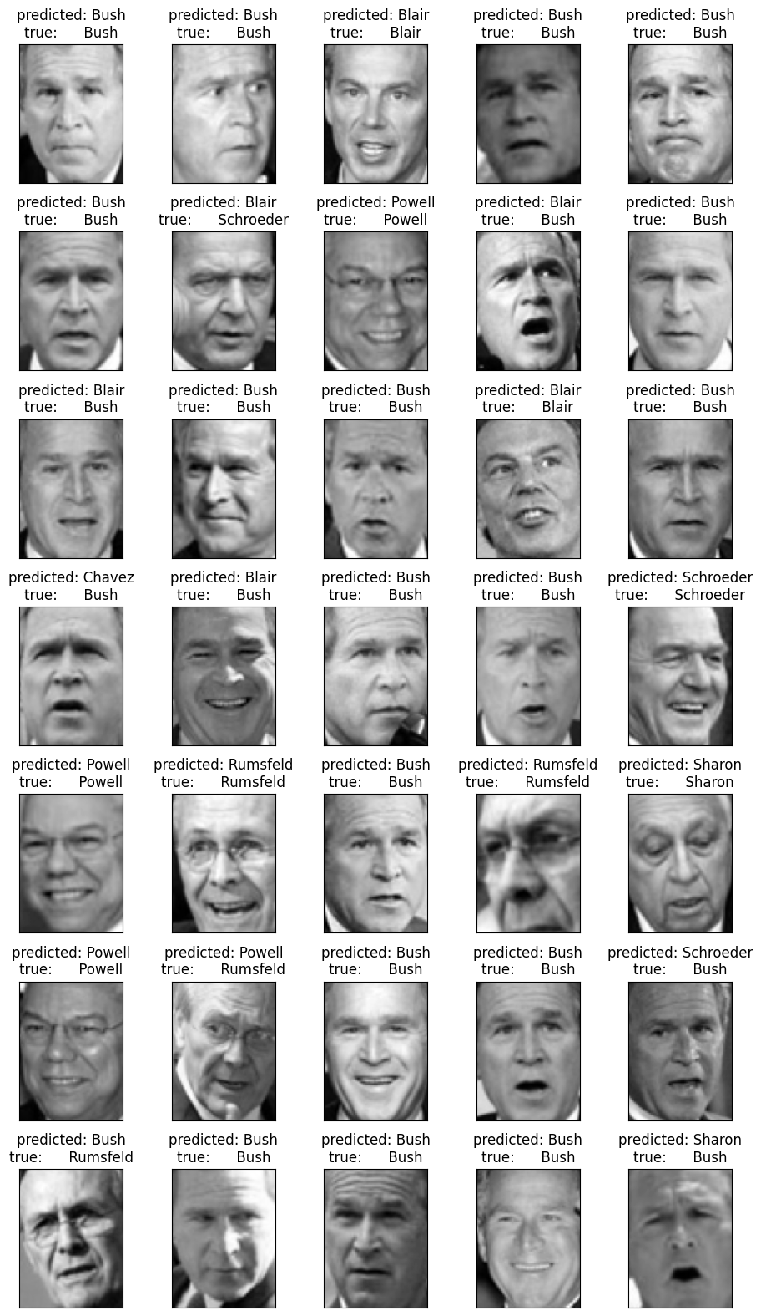
Principal Components, Noise, and Accuracy
Predicted Labels and Actual Labels of 1NN Algorithm

Slide 17
Principal Components, Noise, and Accuracy
Since the eigenfaces method is essentially a dimensionality reduction method when k < max possible k and principal components are chosen in decreasing order by their explained variance (or by their eigenvalues), we will always remove linearly noisy features before we remove informative features
This means that when an optimal choice of k is chosen on a dataset with many noisy features, the accuracy may increase
This is regardless of the “explained variance” of the k principal components because the “explained variance” is the variance of X not of y
Note: PCA is completely invariant to y. The method can only be applied to the feature matrix without respect to what y may be
This may increase or decrease the accuracy depending on factors

Slide 18
Modeling
Models considered:
KNN
Random Forest
Logistic Regression
SVM
Model Evaluation:
Repeated Stratified K-Fold
10 folds
2 repeats
Hyperparameter Tuning:
Randomized Grid Search

Slide 19
Model Performance
KNN
Best Accuracy: 0.737
K = 5
Random Forest
Best Accuracy: 0.672
Number of trees = 87, Max depth = 16
Logistic Regression
Best Accuracy: 0.797
Penalty = l2, multinomial distribution for multiclass method, C = 0.234
SVM
Best Accuracy: 0.827
Kernel = rbf, gamma = scale, degree = 2, C = 0.95

Slide 20
Important Considerations
Since PCA finds characteristic features of the images with respect to the mean face, any face that’s orientation, position, or lighting varies drastically from the mean face may not be represented well when projected onto the eigenspace for comparison
In other words, we need a way to control for centering, orienting, and adjusting lighting for the face before modeling for best result. We also need to make sure these controls are as constant as possible before training
All these considerations can be accounted for by preprocessing the data

Slide 21
Generalizing to Outside Images

Slide 22
Validation Set
We collected images from google images corresponding to the class labels (names)
Five “random” images per class
These images were then preprocessed given the previous considerations

Slide 23
Preprocessing: Position and Orientation
To find the position of a face inside a larger image, we used the RetinaFaces package
This package allows us to use a pretrained deep learning model to detect the location of the face
Crop location of the face and resize image to same aspect ratio as trained images
This allows us to center and orient the face similar to the training data

Slide 24
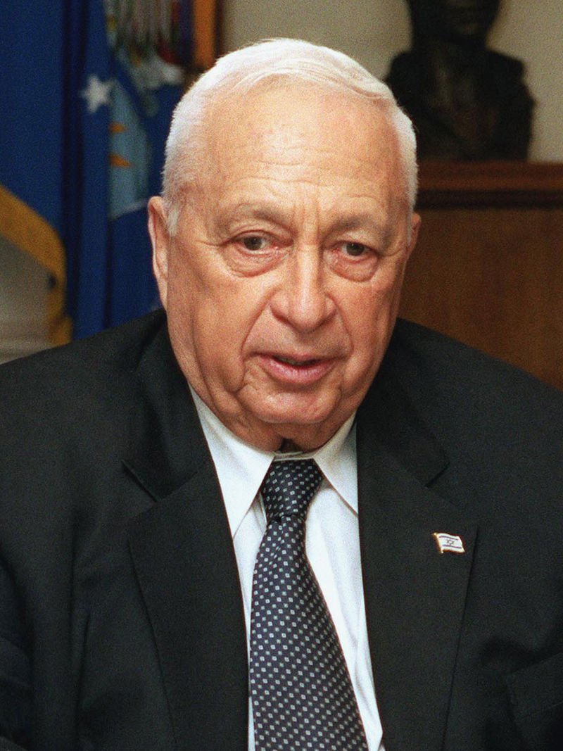
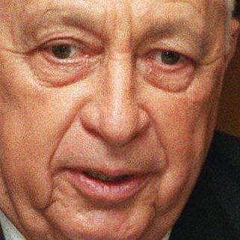
Face Location Detection Ex:

Slide 25
Preprocessing: Lighting
First we have to grayscale the image
We also performed histogram equalization to improve contrast and lighting in the image
This was to make the features and contrast in pixel values more evident and clear

Slide 26

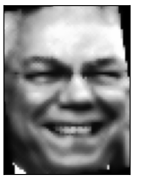
Full Preprocessing Example

Slide 27
Validation Set Results
Using the optimized models from before we test on the validation set to the following results:
1NN
0.312 Accuracy
KNN
0.143 Accuracy
Logistic Regression
0.171 Accuracy
SVM
0.257

Slide 28
Notes on Results
Random chance accuracy is 1/7 or about 0.143
Our optimized KNN model did about just as well as random chance
1NN is best performing model on validation set
All models perform significantly worse

Slide 29
Differences in Trained Data and Validation Set are too Large
Even in our attempts to control for the considerations, likely the poor performance may just be due to differences in the standardization of position, orientation, and lighting
Visual similarity =/= similarity by algorithmic measurements
There is no standard way to preprocess images
Preprocessing for training images needs to be same for images to be recognized

Slide 30
Conclusion

Slide 31
PCA and Eigenfaces
Uniquely simple and effective in regards to:
Extremely intuitive
We turn pixels (meaningless features for faces) into characteristic features of faces
Not interpretable at a low level but can be somewhat understood at a high level
Can denoise data
Feature extraction
Strong importance on preprocessing of faces
Generalizability is difficult to measure and implement
Pose
Orientation
Lighting

Slide 32
Possible Future Work
Clear areas for improvement
Preprocess images more similarly to training data
Account for lighting via principal component selection
First three eigenfaces tend to be attributable to lighting so it is sometimes common to remove them
Distortion of input images
Possible areas for improvement
Cropping
Centering of face is likely fine but cropping from the center (bounding boxes) not clear

Slide 33
Related Work
Eigenfeatures
Perform eigenfaces algorithm but on specific features of the face (eyes, mouth, nose, etc.)
More expensive on memory
Doesn’t account for spatial differences between features of face
Allows for recognition with only part of the face exposed
Fisherfaces
More computationally expensive
Typically more accurate
Can’t reconstruct faces with fisherfaces

